Slide 1
MOSFET

Slide 2
WHAT IS A MOSFET?
Metal Oxide Semiconductor Field Effect Transistor
Terminals are: Source, Drain, Gate and Substrate
used for switching and amplification in circuits

Slide 3
There are 2 types of MOSFET’s:
Depletion mode MOSFET (D-MOSFET)
Operates in Depletion mode the same way as a JFET when V_{GS} ≤ 0
Operates in Enhancement mode like E-MOSFET when V_{GS} > 0
Enhancement Mode MOSFET (E-MOSFET)
Operates in Enhancement mode

Slide 4
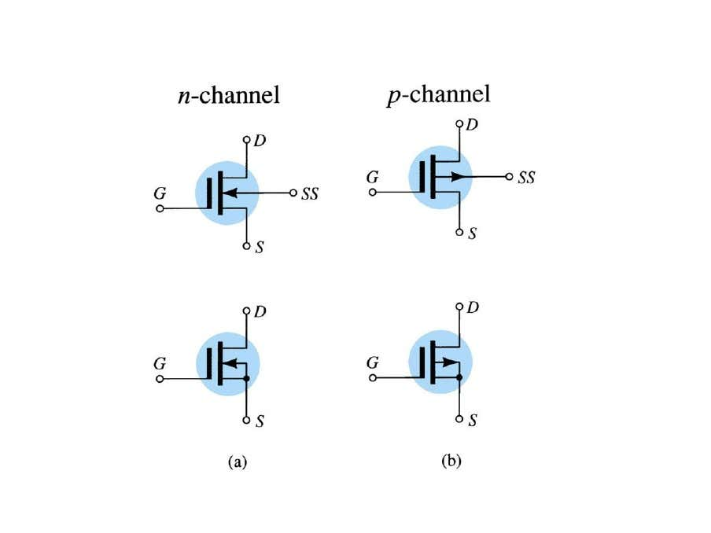
D-MOSFET

Slide 5
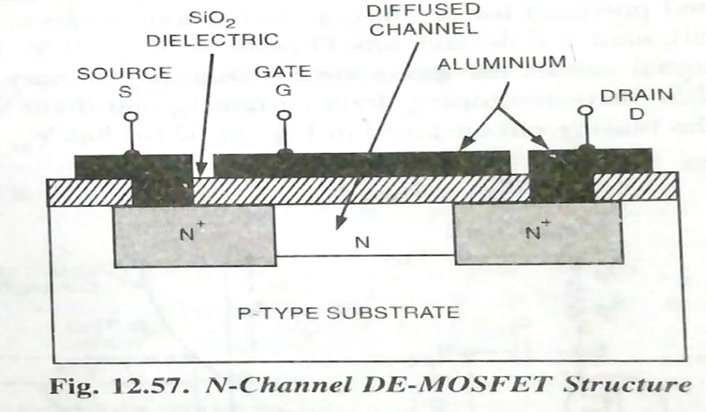
Depletion Mode MOSFET Construction
In the depletion mode construction a channel is physically constructed and a current between drain and source is due to voltage applied across the drain-sourse terminals.
It consists of a highly doped P-type substrate into which two blocks of heavily doped N-type material are diffused forming the source and drain.

Slide 6
An N-channel is formed by diffusion between the source and drain.
A thin layer of SiO₂ dielectric is grown over the entire surface and holes are cut through the SiO₂) layer to make contact with the N-type blocks (Source and Drain).
Metal is deposited through the holes to provide drain and source terminals, and on the surface area between drain and source, a metal plate is deposited. This layer constitutes the gate.
A P-channel DE-MOSFET is constructed like an N-channel DE-MOSFET, starting with an N-type substrate and diffusing P-type drain and source blocks and connecting them internally by a P-doped channel region.

Slide 7
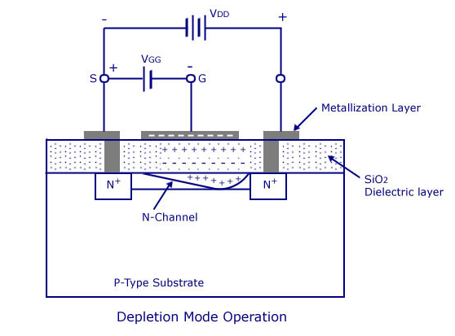
OPERATION
There is no PN junction between gate and channel.
The diffused channel N, the insulating dielectric SiO2 layer and the metal layer of the gate forms a parallel plate capacitor.
D-MOSFET can be operated with either a +ve or a –ve gate.
When gate is +ve w.r.t. source, it operates in enhancement mode and When gate is -ve w.r.t. source, it operates in depletion mode.

Slide 8
E –mode operation
When the drain is made positive with respect to source, a drain current will flow, even with zero gate potential and the MOSFET is said to be operating in E-mode.
In this mode of operation gate attracts the negative charge carriers from the P-substrate to the N-channel and thus reduces the channel resistance and increases the drain-current.
The more positive the gate is made, the more drain current flows.

Slide 9
Depletion mode operation
when the gate is made negative with respect to the substrate, the gate repels some of the negative charge carriers out of the N-channel.
This creates a depletion region in the channel, as illustrated in figure, and, therefore, increases the channel resistance and reduces the drain current.
The more negative the gate, the less the drain current.
In this mode of operation the device is referred to as a depletion-mode MOSFET.

Slide 10
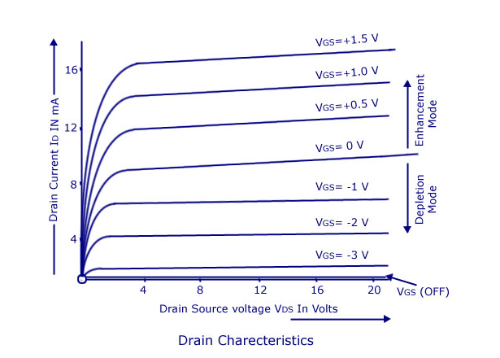
Characteristics of DEMOSFET
Drain characteristics
The upper curves are for positive V_{GS} and the lower curves are for negative V_{GS}.
The bottom drain curve is for V_{GS} = V _{GS}(OFF). For a specified drain-source voltage V_{DS}, V_{GS} (OFF) is the gate-source voltage at which drain current reduces to a certain specified negligibly small value, as shown in figure.

Slide 11
Characteristics of DEMOSFET
Drain characteristics
For V_{GS} between V_{GS} _{(0FF)} and zero, the device operates in depletion-mode while for V_{GS} exceeding zero the device operates in enhancement mode.
These drain curves again display an ohmic region, a constant-current source region and a cut-off region.

Slide 12
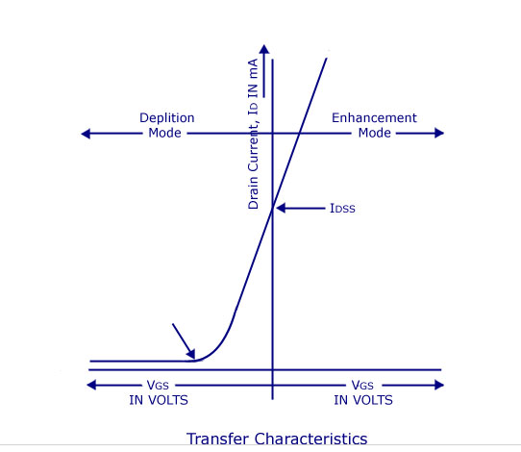
Transfer (or transconductance) characteristic
I_{DSS} is the drain current with a shorted gate. Since the curve extends to the right of the origin, I_{DSS} is no longer the maximum possible drain current.

Slide 13
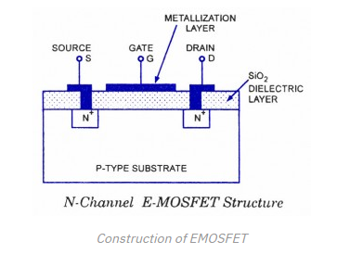
ENHANCEMENT MOSFET(E - MOSFET)
Construction of an EMOSFET
No channels are doped between the source and the drain.
Channels are electrically induced in these MOSFETs, when a positive gate-source voltage V_{GS} is applied to it.

Slide 14
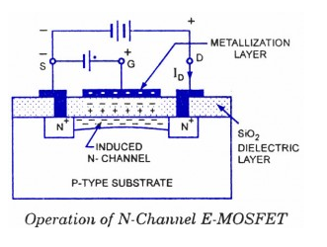
Operation
It operates with large positive gate voltage only.
It does not conduct when the gate-source voltage V_{GS} ⁼ 0. So it is called normally-off MOSFET.
In these MOSFET’s drain current I_{D} flows only when V_{GS} exceeds V_{GST} [gate-to-source threshold voltage].
When drain is applied with positive voltage with respect to source and no potential is applied to the gate two N-regions and one P-substrate from two P-N junctions connected back to back .
So a very small drain current that is, reverse leakage current flows.

Slide 15
Operation
When the gate is made positive with respect to the source and the substrate, negative (i.e. minority) charge carriers within the substrate are attracted to the positive gate and accumulate close to the-surface of the substrate.
As the gate voltage is increased, more and more electrons accumulate under the gate.
Since these electrons can not flow across the insulated layer of silicon dioxide to the gate, so they accumulate at the surface of the substrate just below the gate.

Slide 16
Operation
These accumulated minority charge carriers make N -type channel stretching from drain to source.
When this occurs, a channel is induced known as an inversion layer (N-type). Now a drain current start flowing.
The strength of the drain current depends upon the number of charge carriers attracted to the positive gate.
Thus drain current is controlled by the gate potential.

Slide 17
Operation
The minimum value of gate-to-source voltage V_{GS} that is required to form the inversion layer (N-type) is termed the gate-to-source threshold voltage V_{GST}.
For V_{GS} below V_{GST}, the drain current I_{D} = 0.
But for V_{GS} exceeding V_{GST} an N-type inversion layer connects the source to drain and the drain current I_{D} is large.
Depletion-mode devices are normally ON when the gate-source voltage V_{GS} = 0, whereas the enhancement-mode devices are normally OFF when V_{GS} = 0.

Slide 18
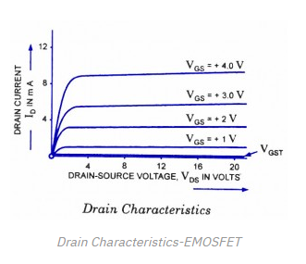
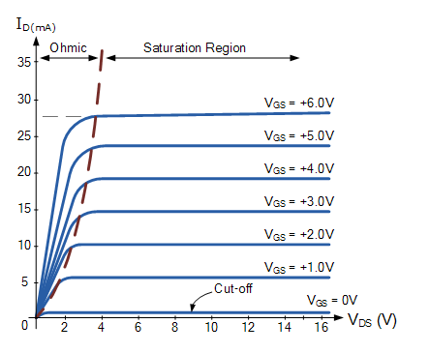
Characteristics of EMOSFET
Drain characteristics
The lowest curve is the V_{GST} curve. When V_{GS} is lesser than V_{GST}, I_{D} is approximately zero.
When V_{GS} is greater than V_{GST}, the device turns- on and the drain current I_{D} is controlled by the gate voltage.
The almost vertical components of the curves correspond to the ohmic region, and the horizontal components correspond to the constant current region.
E-MOSFET can be operated in either of these regions i.e. it can be used as a variable-voltage resistor (WR) or as a constant current source.

Slide 19
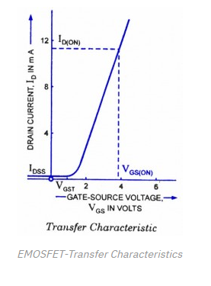
Characteristics of EMOSFET
Transfer characteristics
The current IDSS at VGS <=0 is very small.
When the V_{GS} is made positive, the drain current I_{D} increases slowly at first, and then much more rapidly with an increase in V_{GS}.
he equation for the transfer characteristic of E-MOSFETs is given as:
I_{D}=K(V_{GS} - V_{GST})²

Slide 20
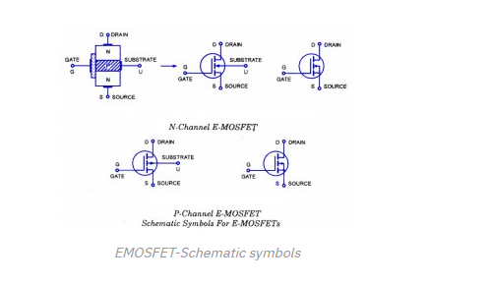

Slide 21
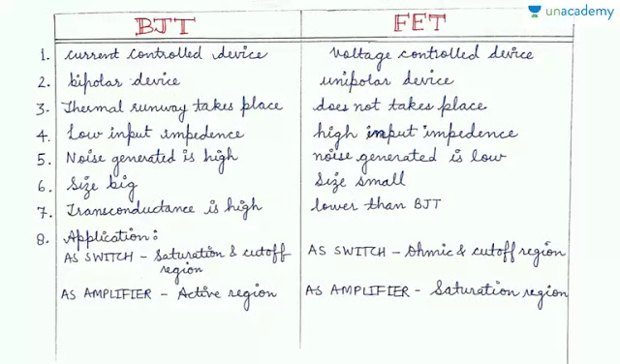

Slide 22
Why N channel mosfet are preferred over P channel?
The N-channel majority carriers (electrons) have a higher mobility than the P-channel majority carriers (holes).
Thus an N-channel device is faster than a P-channel device.

